Slide 1
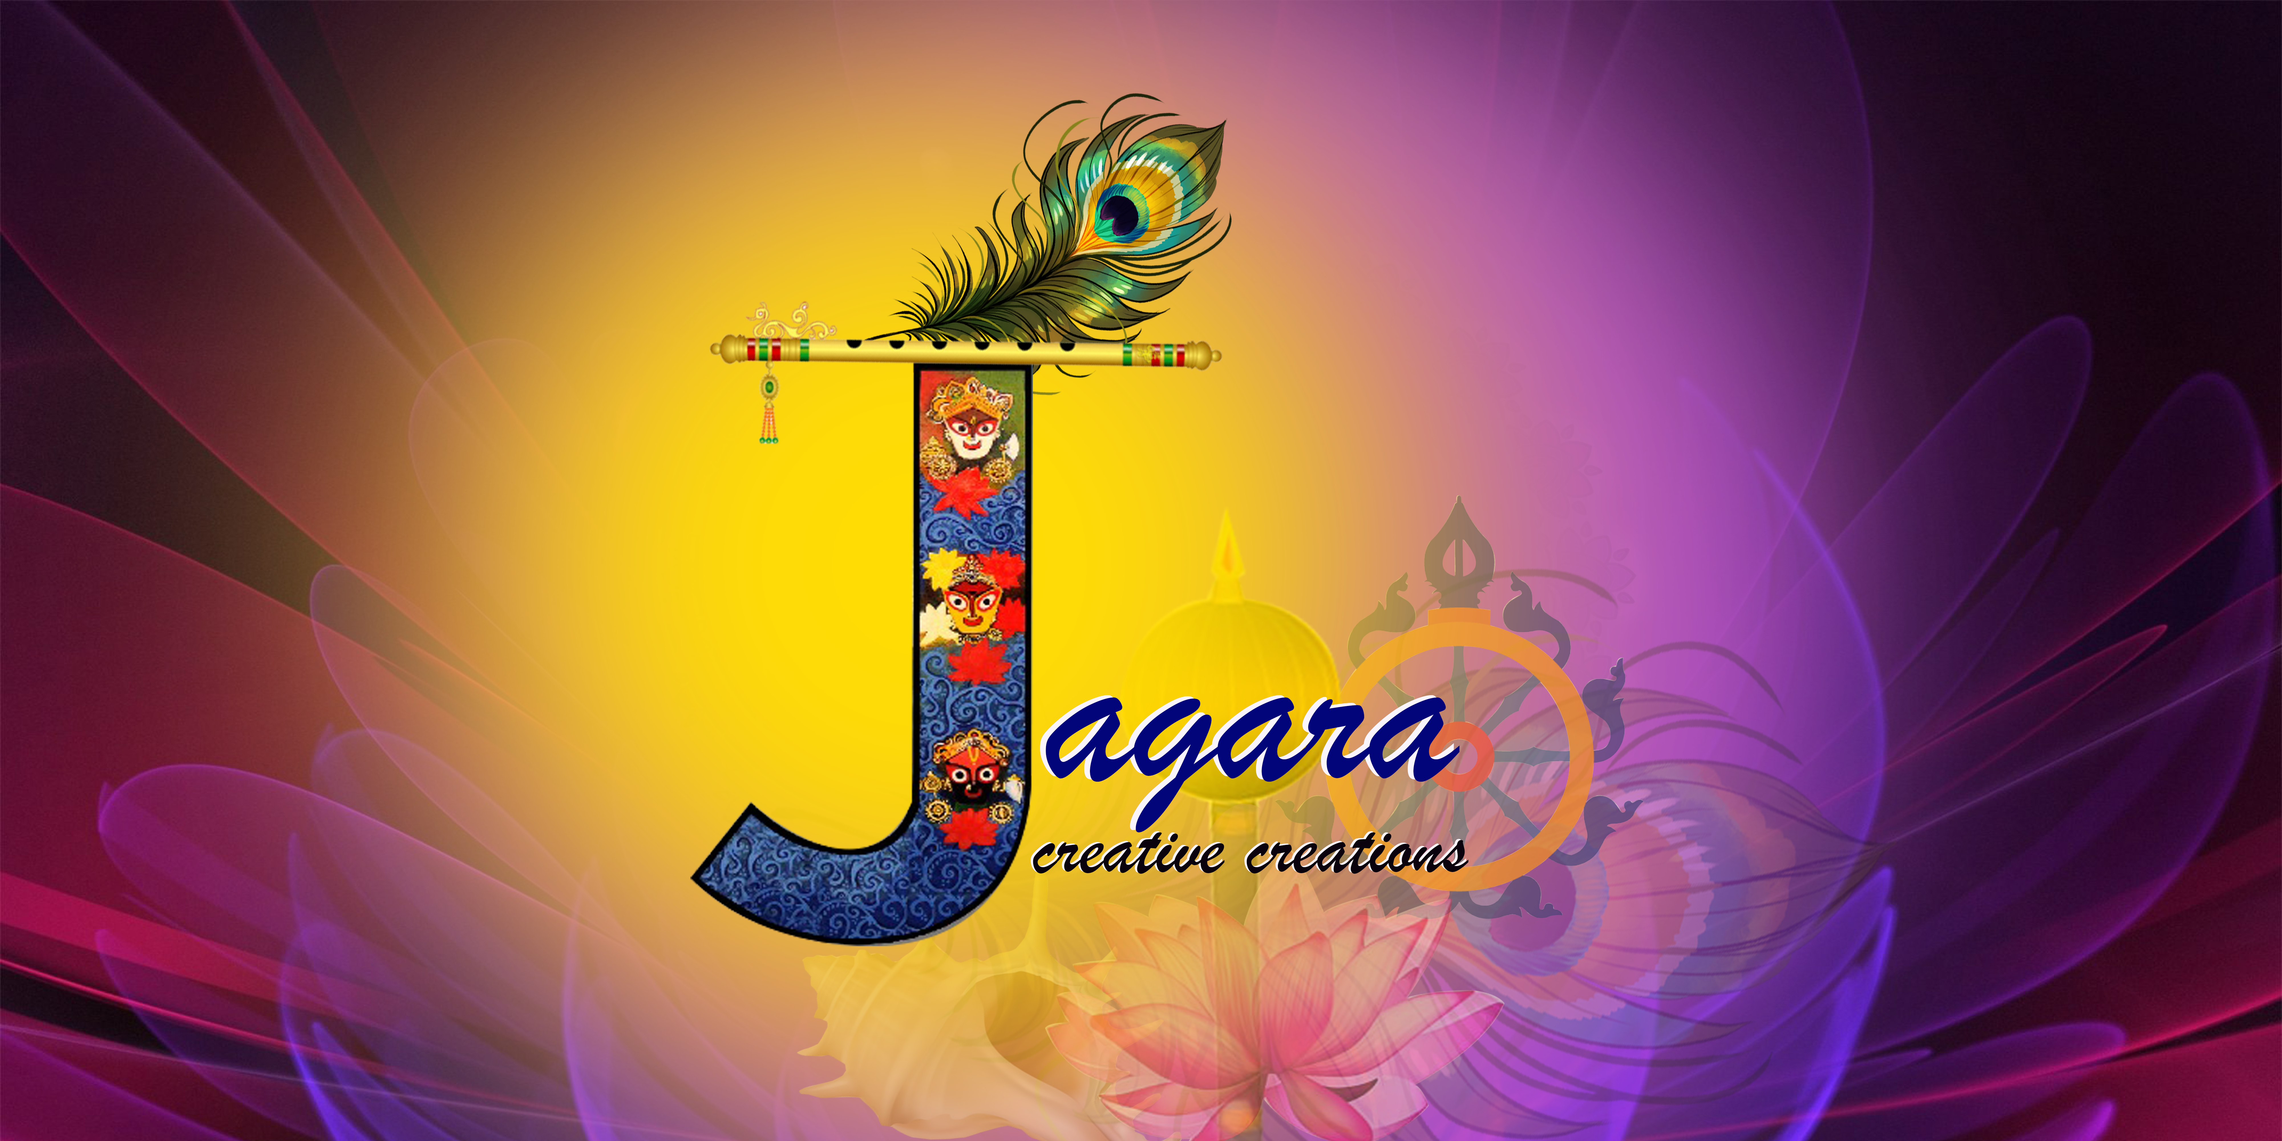

Slide 2
Contents:
Background.
Executive Summary - What is Jagara?
Why Jagara – The Solution to the Problem.
Emerging Technologies – The Blockchain.
The digitization of real-world assets into tokens on the blockchain.
What is the NFT Market place.
Addressing Safety and Security.
Addressing Copyright and (or) Patent of Intellectual Properties.
Addressing real-time payment issues.
Addressing the supply of raw materials and export issues.
Addressing middleman issue.
Software Solution – Jagara – Our own NFT marketplace.
Business Model – Jagara.
Technical Approach.
Prototype Costing.

Slide 3
Background 1 : Art & Craft in Odisha
Odisha was known as Utkala during ancient and medieval times. Utkala the name itself means – the land of excellence in art and craft. The art forms are visual manifestations of the rich cultural heritage of Odisha and reflect a tradition that still lives in the creative imagination and skill of her craftsmen.
Diverse, vibrant, and utilitarian the art and craft of Odisha range from —stonework, silver filigree, woodcraft, appliqué work, brass and bell metal work, dhokra castings, horn work, pattachitra, paper mache, terracotta, tie & dye textile in cotton,tassar and silk to name a few. Stemming from centuries of exquisite craftsmanship, they are a colorful testimony to the integral life force of the people of the state.

Slide 4
Background 2 : Art & Craft in Odisha
-------- It’s Dying!!!
Lots of research happened to date.
Lots of papers published by now.
Lots of initiatives taken by the Government and other entities.
But it’s still dying.
Artists and Craftsmen still not getting enough to build up a better living for themselves.
Giving a good education to their kids.
Not able to substantiate their belief in their long and inherited assets, the knowledge they have got from their parents, generation to generation.

Slide 5
Problems : Money Matters
May it be a master craftsman, a dealer, or an artist they all are facing problems in
getting irregular payments
irregular supply of raw materials
No regular orders from associated societies
Problems with Co-operative Societies
Problems of craftsmen in raising loans
Proper coordination of all stakeholders
Not having a standard and well-reached marketplace
Not having a proper channel for export
Many middle-men, collaborators, agents
Copyright and Intellectual property loss without any benefit

Slide 6
Jagara : Executive Summary
Jagara is a unique initiative to help the livelihood of Artists and Craftsmen in Odisha by providing one of its kind marketplaces for those genius who are struggling for their livelihood.
And ultimately forced to leave their forefather’s knowledge, and get into the current mechanical life. It is going to be the marketplace,
Which will value their creations.
Will provide enough pride and price for their own intellectual property.
Will give them respect in society, by promoting their work worldwide, but in a very secure and authentic manner.
Removing most of the middlemen.
Collaborating with Govt, private, banking, insurance, and other agencies.
Will initiate it in Odisha, and then will implement it in Pan India and Asia-Specific regions.

Slide 7
Jagara : A Creative Creation
solution to the problem
Jagara, as the name suggests, it’s of Lord Jagannath!!!
By using the new-age blockchain technology, one can digitalize real-world assets into tokens on the blockchain.
Unlocking the value of physical assets as digital tokens. By representing physical assets as digital tokens on a distributed digital ledger or blockchain, it’s possible to unlock the value of real-world assets and exchange them in real time in a more authentic way.
Accelerating the exchange of value using blockchain. Today’s cross-border payment processes are fraught with time delays, complexity, and inefficiencies. Payments are the backbone of global commerce, but payment in real time has yet to be achieved. Whether it’s payments or other asset classes, the ability to move real-world assets onto a blockchain offers the advantages of a secure digital platform, while retaining the characteristics of the asset.

Slide 8
The digitization of real-world assets
into tokens on the blockchain
1. Unlocking the value of physical assets as digital tokens
Today, it takes one click to buy an airline ticket or a new sweater, but if you want to buy stocks or get a mortgage, transactions are more time intensive. Whether it’s waiting for documents or settlement, many types of transactions aren’t instant. Assets like gold, real estate, fine art, or carbon credits are more difficult to transfer, often obligating buyers and sellers to contend with mountains of paperwork and lengthy procedures. By representing physical assets as digital tokens on a distributed digital ledger or blockchain, it’s possible to unlock the value of real-world assets and exchange them in real time.
2. Accelerating the exchange of value using blockchain
Today’s cross-border payment processes are fraught with time delays, complexity, and inefficiencies. Payments are the backbone of global commerce, but payment in real-time has yet to be achieved. Whether it’s payments or other asset classes, the ability to move real-world assets onto a blockchain offers the advantages of a secure digital platform, while retaining the characteristics of the asset. Securitization is the process through which contractual obligations such as mortgages, car loans, personal debt, or receivables are pooled, and their cash flows are sold as standard units to investors.
Digitization of assets is a process in which the rights to an asset are converted into a digital token on a blockchain. Ownership rights are transmitted and traded on a digital platform, and the real-world assets on the blockchain are represented by digital tokens.

Slide 9
What is the NFT Market place
A non-Fungible Token or NFT marketplace is a marketplace that functions as a public Blockchain platform. However, this platform is gaining traction and driving developers and businesses to construct a marketplace, despite being in its nascent stage.
Online marketplaces for digital assets are the recent talk of the fintech town. But, of course, you have to build your own marketplace if you are planning to set foot in the digital market. The words cryptocurrency trading and blockchain technology are no longer unknown, and many people trade goods on several marketplaces.
Proponents of NFTs claim that NFTs provide a public certificate of authenticity or proof of ownership. The ownership of an NFT as defined by the blockchain has no inherent legal meaning and does not necessarily grant copyright, intellectual property rights, or other legal rights over its associated digital file.
Conceptualizing NFT marketplace
It is a platform that makes it simple to store and sell NFTs. These tokens are generally available for purchase or auction at a set price. To use an NFT marketplace, you will need a crypto wallet to store and trade your best NFT tokens.
Users have to create an account, upload digital artwork, and sell their work on the marketplace. In general, specialized marketplaces are more popular than conventional ones because they include everything a client would require—specialized marketplaces’ expertise in promoting online artworks and concentrating on specific target audiences.

Slide 10
Addressing Safety and Security
RFID chips, barcodes, and QR codes are not suitable for securing physical assets in a tracking process, because they can be copied. Therefore, the counterfeiters could add a tracking feature to their fake products. The idea of tracking physical objects through PUFs is not new, but there is no concept of how this immutable property can be transferred to the digital layer. The blockchain is regarded as an unchangeable data structure due to the decentralized architecture, which is why we will examine how these technologies can be used to secure the distribution pathways of products.
The drying process results in cracks and patterns that are unique, their origin is chaotic and not predictable. The crack patterns are produced on different granularities in terms of crack size, depending on the varnish used. The resulting pattern can be read as a fingerprint for physical products. This means that each product can be uniquely identified. Some paints lead to fine cracks that can only be seen under a microscope. Other lacquer results in a rough crack pattern, which is already clearly visible in pictures taken with conventional mobile phone cameras.
These are particularly suitable for use in the supply chain, as these mobile devices are accessible to the mass market. The crack pattern of the varnish is unique if the product packaging or the product itself is provided with it.

Slide 11
Addressing Copyright and (or) Patent of Intellectual Properties
Blockchain is a data structure or a method to store digital records in a decentralized way – implying that no central authority has access to the operations of this system. As a result of this robust approach, a blockchain-based system is always unhackable, transparent, and of course, immutable as well.
Data in the blockchain is stored in a decentralized manner. This means data is not stored on one server as in classic software systems. Even cloud systems use centralized servers. Blockchain data is distributed over the network by connected devices, so-called nodes. Blocks are linked to each other resulting in a chained data structure. These blocks are secured by cryptography.

Slide 12
Addressing real-time payment issues
By establishing a decentralized ledger for payments (e.g., Bitcoin), blockchain technology could facilitate faster payments at lower fees than banks.
Many types of financial assets are already digital, such as when cash is represented as numbers on a screen. But tokens enable certain assets to move swiftly across digital platforms or networks. Opportunities for cross-border trade increase as geographic barriers are removed. Tokenization can unlock new markets for previously frozen, underutilized, or illiquid assets and offers possibilities for new types of fractional ownership.
The use of digital assets (sometimes called crypto-currencies) such as XRP (an independent digital asset) can help financial institutions convert funds into the desired currency instantly.
The financial ecosystem needs to be looking at implementing thoughtful regulations that can encourage innovative solutions for cross-border payments. At the same time, any implementation of blockchain technology should be done responsibly, with a careful amount of deliberation over the security, risk, and stability of cross-border payment solutions.

Slide 13
Addressing-supply of raw materials and export issues
To facilitate direct procurement of produce from the Artist.
To facilitate a reduction in logistics costs by streamlining the supply chain.
To facilitate a unified platform to access a diverse range of products.
To facilitate a platform to sell their products on a larger scale.
To facilitate a market analysis model, this will assist them in getting the right price for their produce by analyzing the demand and supply in the market.
To facilitate an efficient hyperlocal delivery service to retailers for their e-commerce.

Slide 14
Software Solution – Jagara – Our own NFT marketplace
Jagara will offer a marketplace allowing for non-fungible tokens to be sold directly at a fixed price, or through an auction, based on the Ethereum ERC-721 standard, the layer-2 scaling solution for Ethereum Polygon, the KIP-7 standard for Klaytn, and the SPL standard for Solana.
Jagara is an online peer-to-peer marketplace where NFTs in the form of gaming items, digital art, and other goods can be bought and sold.
Users can create their own customizable marketplace using the Jagara software and set their own fees for their sales. Users can create auctions for items with any cryptocurrency of their choice. They must submit a contract on the platform to get their auction started. The application programming interface can show users market data with statistics and insights in the form of graphs so users can see how their digital assets are trending. Users can sell their assets in packs, airdrop rewards to customers if so desired, and create loot boxes.
Sales are conducted through smart contracts on the platform, and users can keep their commission after paying a fee to Jagara.

Slide 15
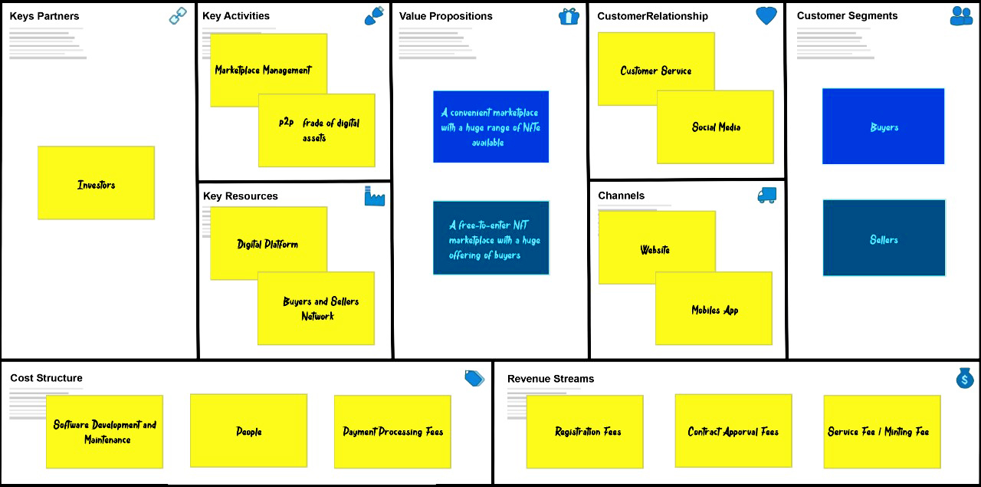
Business Model

Slide 16
Technical Approach-1
Non-fungible tokens (NFTs) are unique, digital items with blockchain-managed ownership. As a marketplace for NFTs, Jagara will have below unique vantage point:
Standardization: By representing non-fungible tokens on public blockchains, developers can build common, reusable, inheritable standards relevant to all non-fungible tokens. These include such basic primitives as ownership, transfer, and simple access control. Additional standards (specifications for how to display an NFT, for example) can be layered on top for rich display inside of applications.
Interoperability: Non-fungible token standards allow non-fungible tokens to move easily across multiple ecosystems. This is possible because open standards provide a clear, consistent, reliable, and permissioned API for reading and writing data.
Tradeability: The most compelling feature enabled by interoperability is free trade on open marketplaces. For the first time, users can move items outside of their original environments and into a marketplace where they can take advantage of sophisticated trading capabilities.

Slide 17
Technical Approach-2
Liquidity: Instant traceability of non-fungible tokens will lead to higher liquidity. NFT marketplaces can cater to a variety of audiences—from hardcore traders to more novice players—allowing for greater exposure of the assets to a wider pool of buyers.
Immutability and provable scarcity: Smart contracts allow developers to place hard caps on the supply of non-fungible tokens and enforce persistent properties that cannot be modified after the NFTs are issued. Developers can also enforce that specific property do not change over time by encoding them on-chain. This is particularly interesting for art, which relies heavily on the provable scarcity of an original piece.
Programmability: Of course, like traditional digital assets, NFTs are fully programmable.

Slide 18
Prototype Costing
 | Person Days(Hour) | Number of days | Per Day Cost($) | Total($)
Architect | 160 | 20 | 300 | 6000
Solidity | 400 | 50 | 250 | 12500
Web 3.0 | 560 | 70 | 120 | 8400
Miscellaneous |  |  |  | 5000
Total |  |  |  | 32000

Slide 19
Thanking You

